Slide 1
Myntra Analysis Using Python
By :- Deepak Kumar

Slide 2

Importing Python Libraries
Getting Data from 3 different Sheet In Excel
From Product Sheet
From Customer Sheet
From Orders Sheet

Slide 3

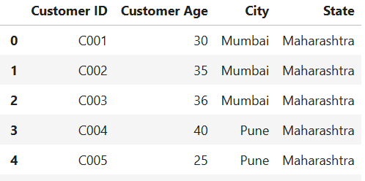

Product Table
Customer Table
Orders Table

Slide 4


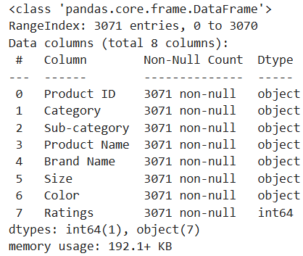
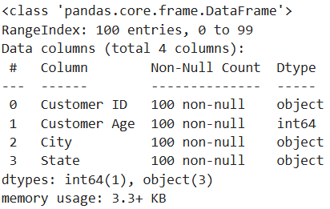
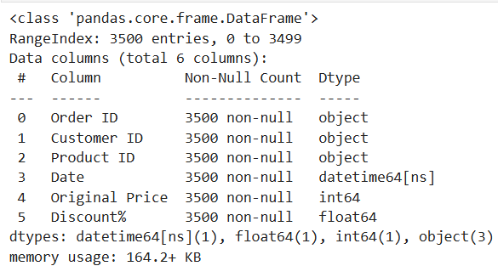
Getting Info

Slide 5



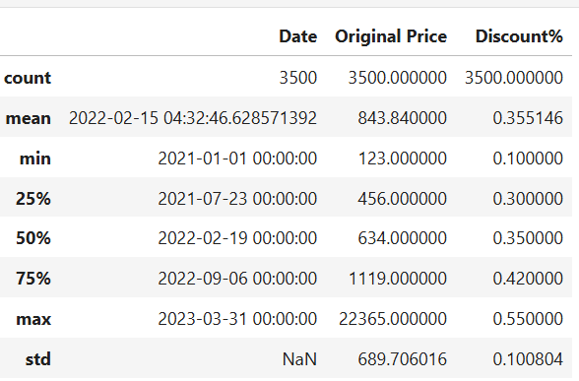
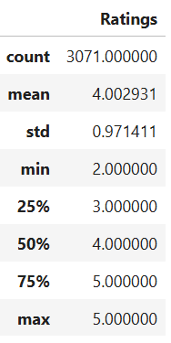
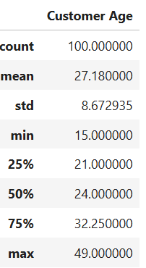
Data Describe

Slide 6
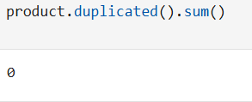
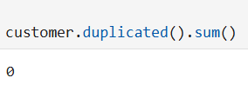




Checking For Duplicate
Checking For Nulls

Slide 7


Creating New Columns As Month

Slide 8

Creating New Columns As Total Price

Slide 9


Creating New Columns As Age Group

Slide 10


Joining Orders and Product Table As op

Slide 11

Joining Orders and Customer Table As oc

Slide 12


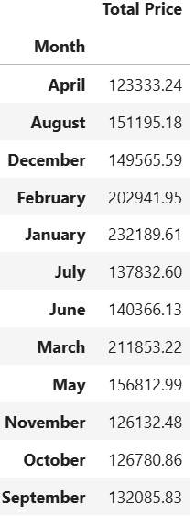
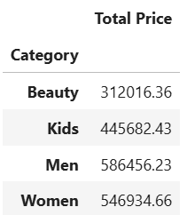
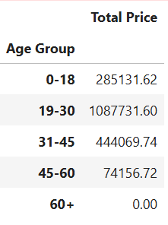

Grouping
Category By Total Price
Month By Total Price
Category By Total Price

Slide 13


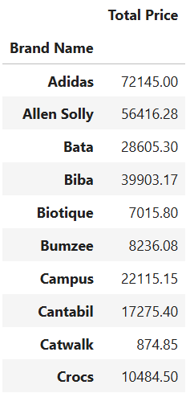
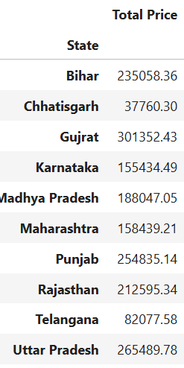
Brand By Total Price
State By Total Price

Slide 14
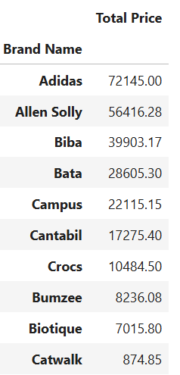
Data Sorting
Top 10 Brand By sales

Slide 15
Data Visualization

Slide 16

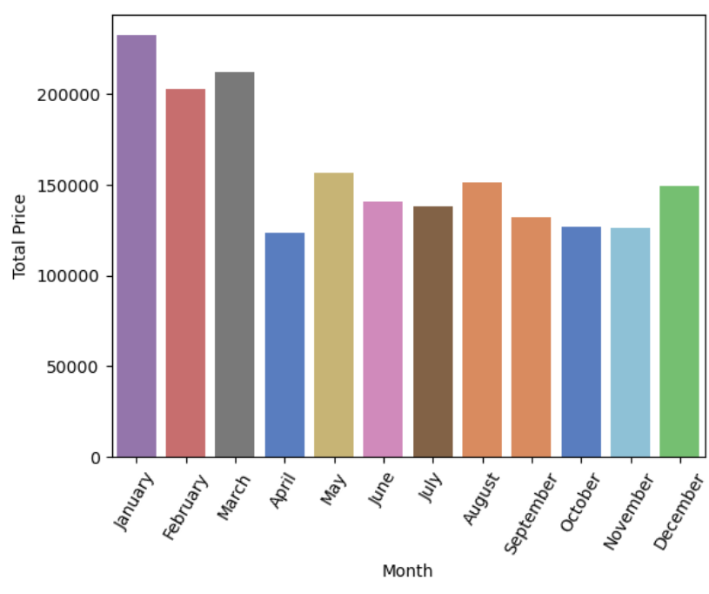
Month by total Price

Slide 17
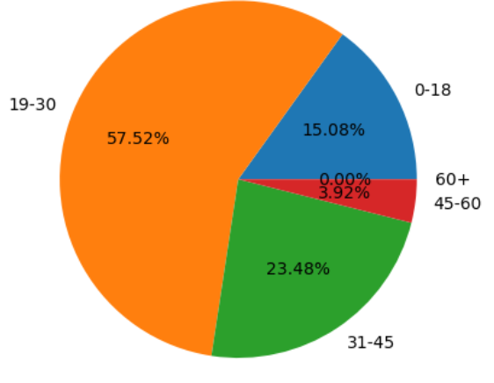
Age Range By Sales

Slide 18

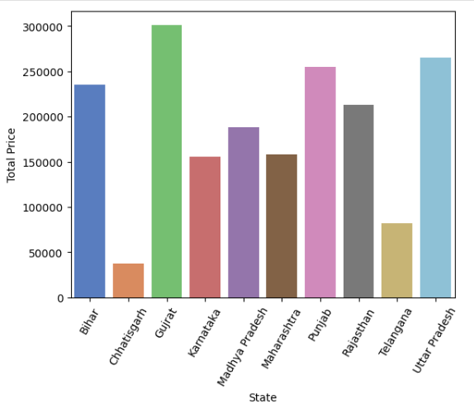
State By Sales

Slide 19
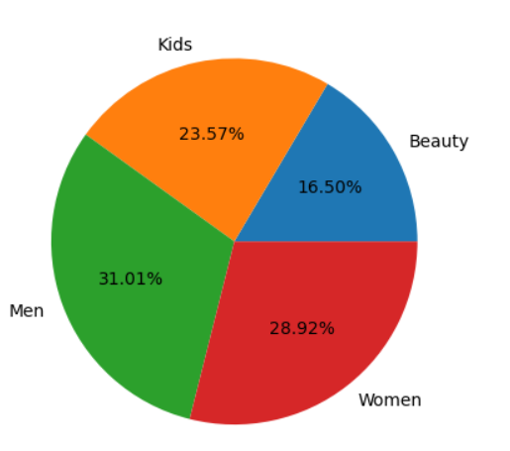
Category By Sales

Slide 20
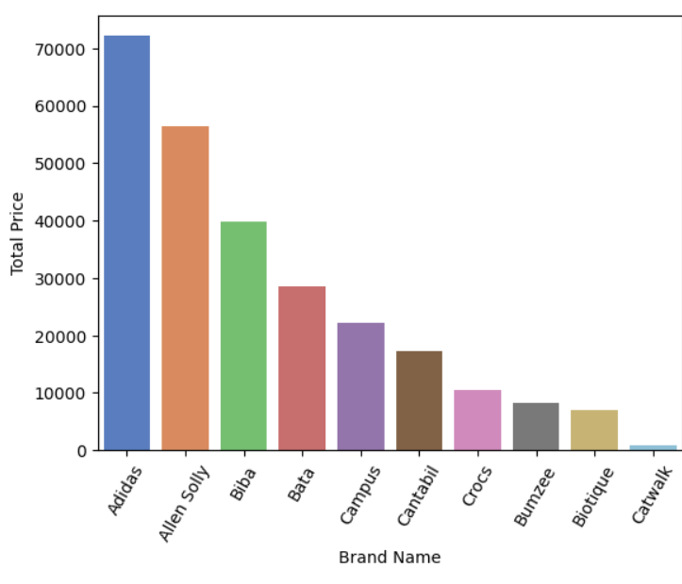
Brand By Sales

